Slide 1
Countries & Nationalities

Slide 2
ROUND
1

Slide 3
Italian
Italy

Slide 4
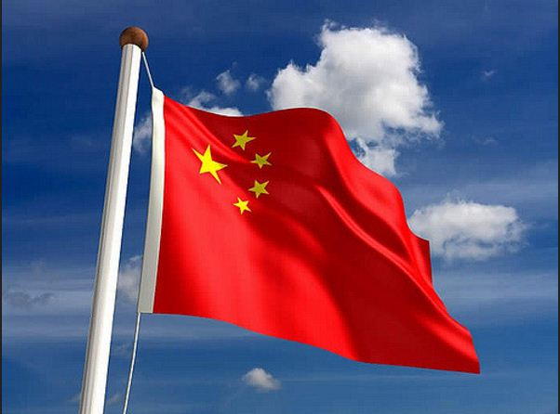
Chinese
China

Slide 5
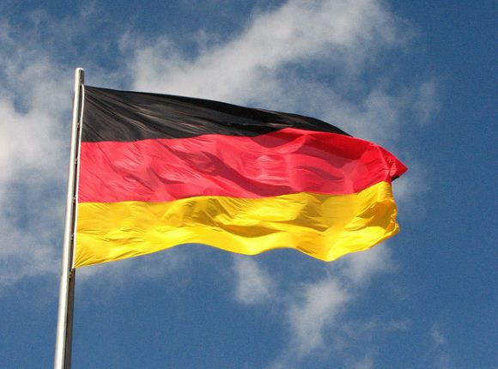
Germany
German

Slide 6
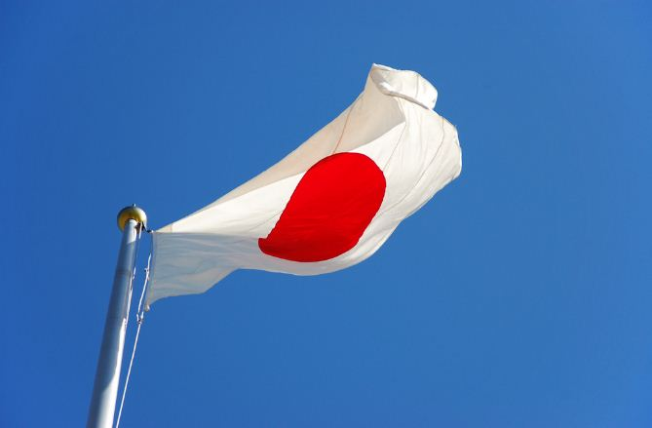
Japan
Japanese

Slide 7
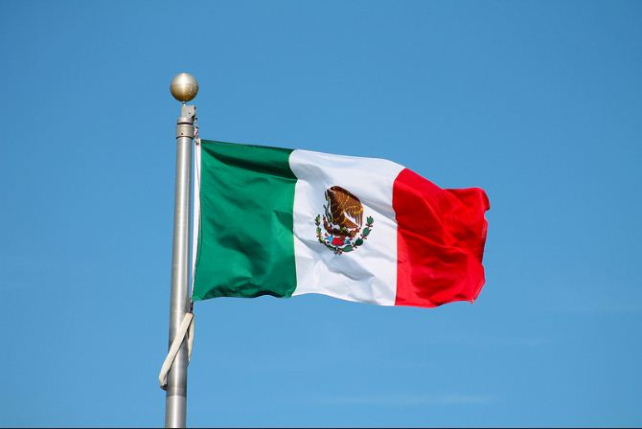
Mexico
Mexican

Slide 8
Egypt
Egyptian

Slide 9
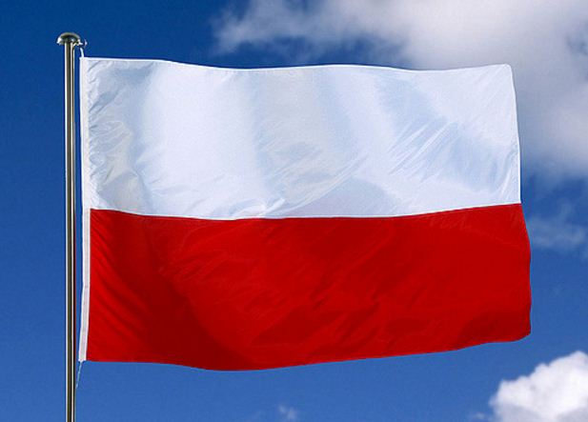
Poland
Polish

Slide 10
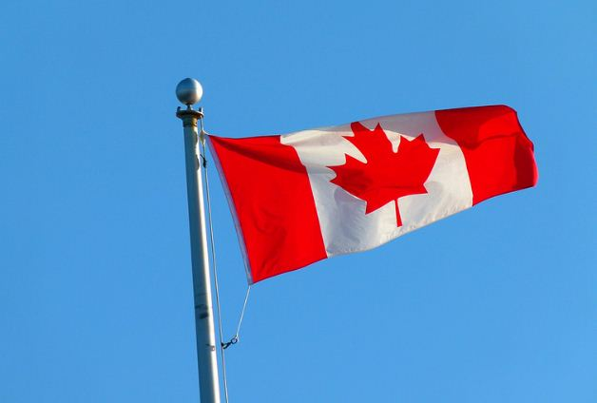
Canada
Canadian

Slide 11
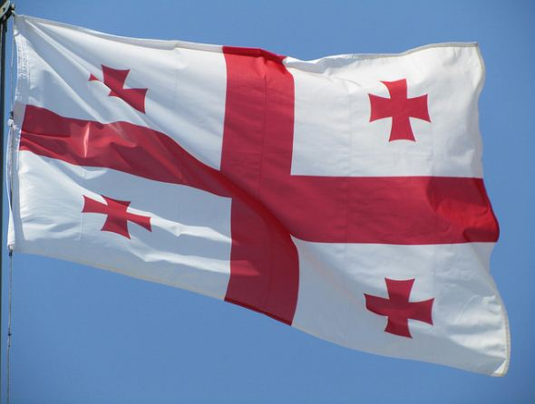
Georgia
Georgian

Slide 12
Spain
Spanish

Slide 13
France
French

Slide 14
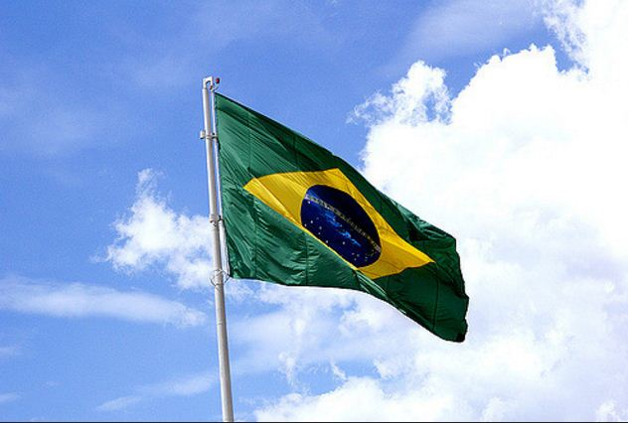
Brazil
Brazilian

Slide 15
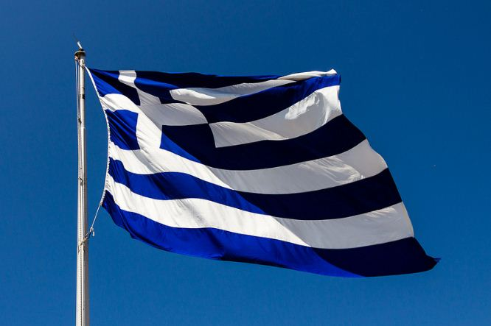
Greece
Greek

Slide 16
ROUND
2

Slide 17
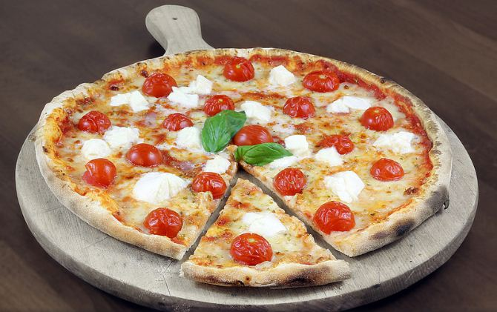
Italian
Italy

Slide 18
Chinese
China

Slide 19
Germany
German

Slide 20
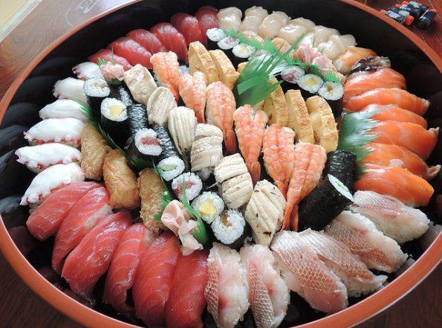
Japan
Japanese

Slide 21
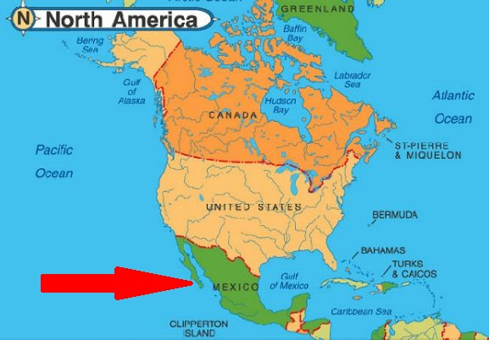
Mexico
Mexican

Slide 22
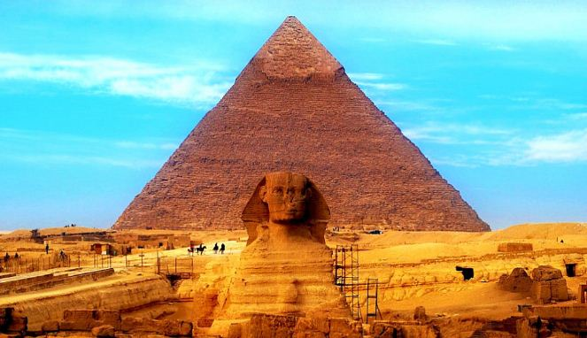
Egypt
Egyptian

Slide 23
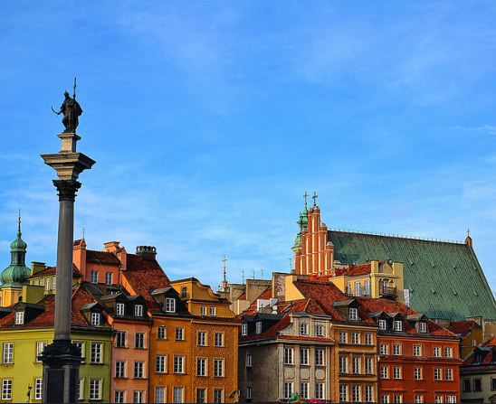
Poland
Polish

Slide 24
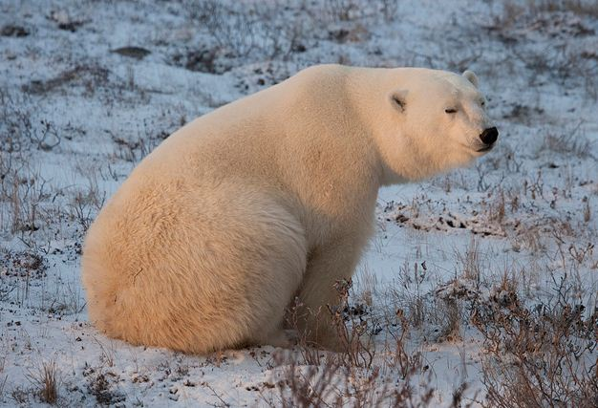
Canada
Canadian

Slide 25
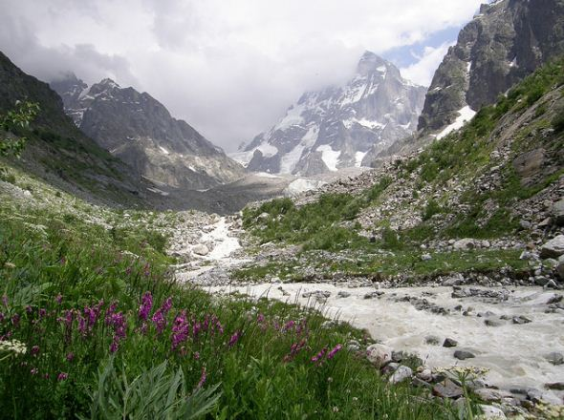
Georgia
Georgian

Slide 26
Spain
Spanish

Slide 27
France
French

Slide 28
Brazil
Brazilian

Slide 29
Greece
Greek

