Slide 1
Kyiv on foot

Slide 2
Not only London on foot
Split into groups of 3.
You have one day to spend in Kyiv and you need to choose one place to visit for your group.
Choose one of the following destinations and discuss in the group which one you consider to be the best one. Be ready to give arguments for your choice.

Slide 3
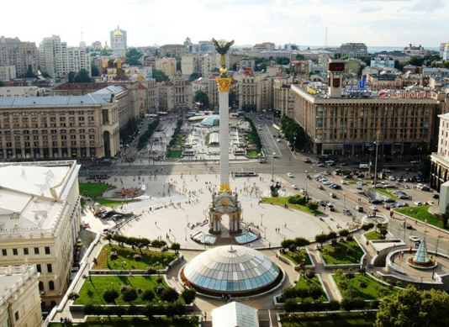

Slide 4
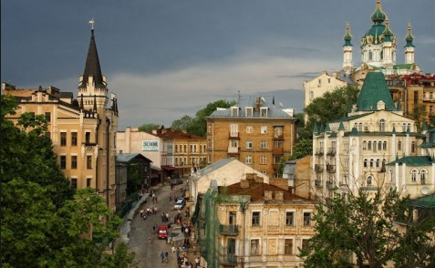

Slide 5
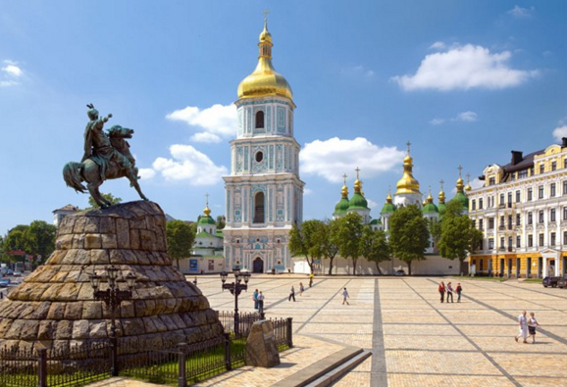

Slide 6
